Slide 1



Lesson 6
Advanced views
Advanced searches
Widgets
Inline Views

Slide 2
Advanced views

Slide 3










In Views modiﬁcation
from odoo import fields, models
class TestModel(models.Model):
_name = "test_model"
_description = "Test Model"
name = fields.Char(required=True, readonly=False)
Field Attributes
Python Code: Available to all views
XML View: Only apply on specific view
Overriding
Field attributes defined in XML can
override the Python Code
...
<field name="name" readonly="1" />
...

Slide 4


Views before
You might see use of “attrs” and “states” in some old views
<field name="name" attrs="{'invisible': [('display_name', '=', False)], 'readonly': [('amount', '!=', 0)]}" />
<button name="action_payslip_cancel" string="Cancel" type="object" states="raft,done,verify" />

Slide 5
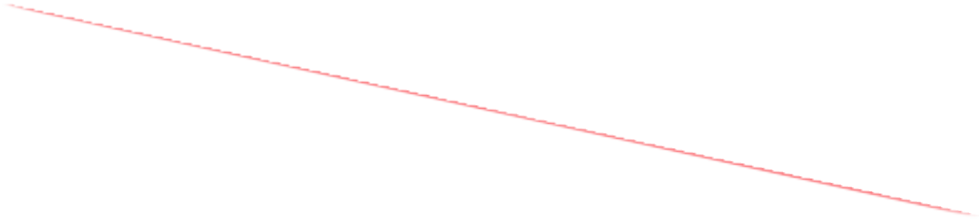
Views before
You might see use of “attrs” and “states” in some old views
<field name="name" attrs="{'invisible': [('display_name', '=', False)], 'readonly': [('amount', '!=', 0)]}" />
<button name="action_payslip_cancel" string="Cancel" type="object" states="raft,done,verify" />
not valid since Odoo 17

Slide 6




Fields attributes
3 Simple in view attributes
readonly
invisible
required
Deal with Python booleans expressions
<field name="description" invisible="1" readonly="1" required="1"/>
To work, fields defined in condition must also be present in the same view !

Slide 7


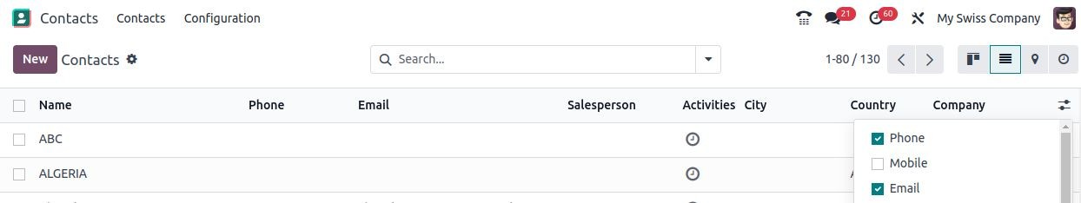


List view attributes
Specific attributes for list views
optional
Same simple attributes
Readonly
Invisible
Required
column_invisible
(can use → parent.xxxx )
<field name="price_description" optional="True" column_invisible="parent.total_amount > 0"/>
Use of view attribute can be useful to prevent data entry errors, but have no level of security!
There is no server-side check done

Slide 8





Views decorators
Color codes are useful to emphasize records
CLICK HERE
decoration-{$name} attribute in view definition
<tree decoration-success="is_partner">
<field name="name"/>
<field name="is_partner"/>
...
</tree>
Can be done:
On line basis (tree view)
On field basis
<field name="name"/>
<field name="is_low" invisible="1"/>
<field name="budget" decoration-danger="is_low"/>
...

Slide 9
Advanced searches

Slide 10

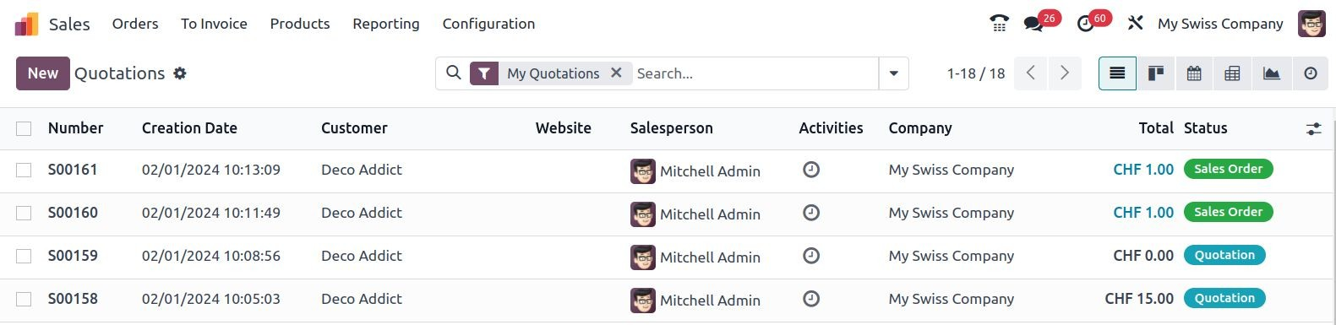

Default Search
We want to set a default filter when we enter a view.
CLICK HERE

Slide 11



Default Search
<search string="Tests">
<filter string="New" name="filter_state" domain="[('state','=','new')]"/>
</search>
Create a filter in search view
Add context key in action definition
<record id="..." model="ir.actions.act_window">
<field name="name">Test action</field>
<field name="res_model">test.model</field>
<field name="view_mode">...</field>
<field name="context">{'search_default_filter_new_state': True,}</field>
</record>

Slide 12


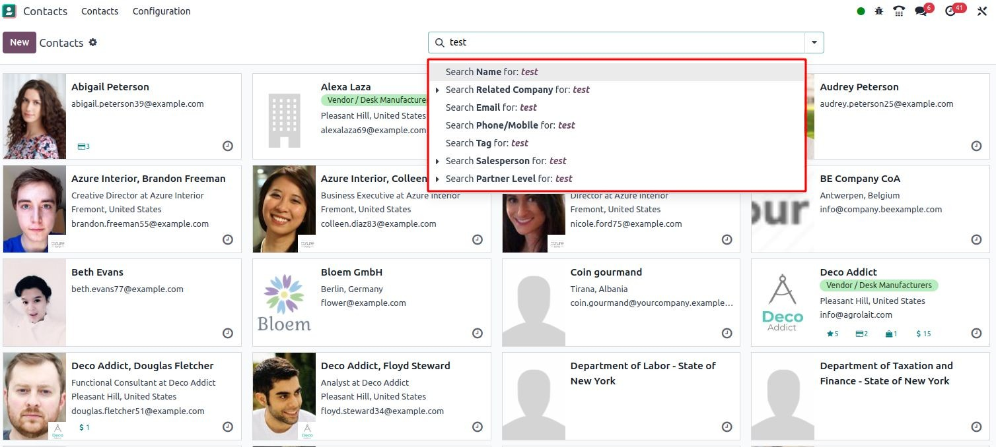

Filter domain
Allow users to search a record by its field without an exact match
CLICK HERE

Slide 13



Filter domain
Add a field in search view
<search string="Tests">
<field name="description" string="Name and description"
Add filter_domain key attribute
filter_domain="['|', ('name', 'ilike', self), ('description', 'ilike', self)]"/>
</search>
→use self to reflect the user’s input

Slide 14
Widgets

Slide 15


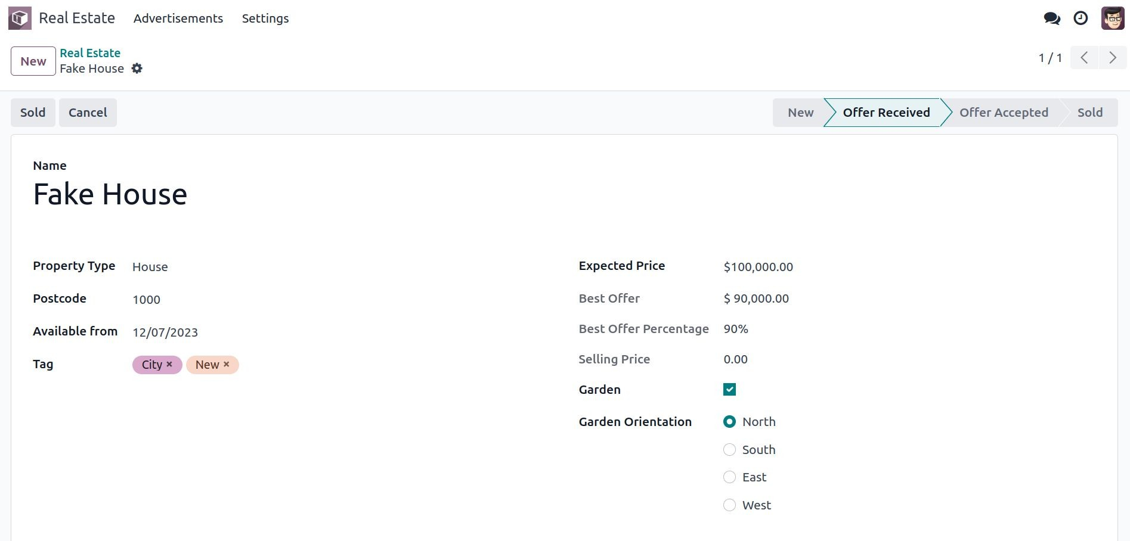

Widgets
statusbar
monetary
percentage
radio
many2many_tags
…
Many different widgets exist !
check in the standard code or in doc to discover them all
CLICK HERE

Slide 16
Widgets
statusbar
monetary
percentage
radio
many2many_tags
…
Display selection field as status bar in header
CLICK HERE

Slide 17
Widgets
statusbar
monetary
percentage
radio
many2many_tags
…
Add currency logo next to field
require currency_id field in model and in view (invisible)
CLICK HERE

Slide 18
Widgets
statusbar
monetary
percentage
radio
many2many_tags
…
Converts Float field into percentage
CLICK HERE

Slide 19
Widgets
statusbar
monetary
percentage
radio
many2many_tags
…
Display selection field in a list of radio buttons
CLICK HERE

Slide 20
Widgets
statusbar
monetary
percentage
radio
many2many_tags
…
Show Many2many fields in a list of tags
(can have colors with option field parameter)
CLICK HERE

Slide 21

Widgets deﬁnition
In each field defined in the view
...
<field
add the widget attribute
name="tag_ids" widget="many2many_tags" options="{'color_field': 'color'}"
add some options if necessary
/>
...
CLICK HERE

Slide 22
Inline Views

Slide 23



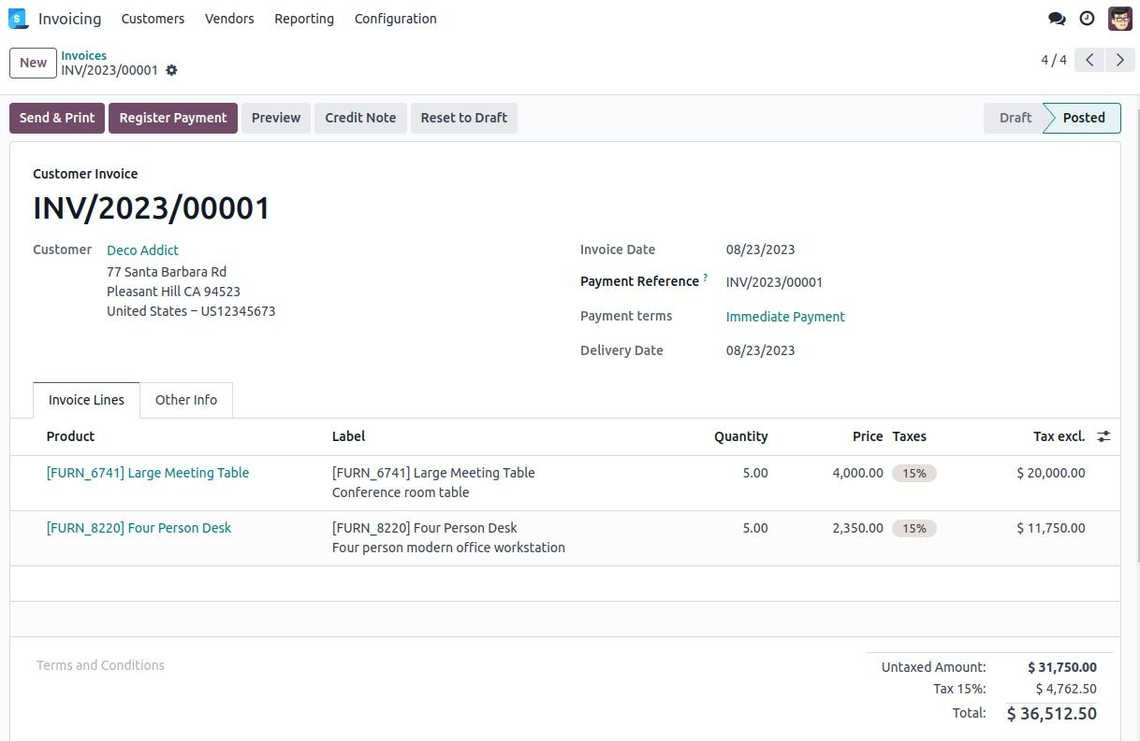

Inline view
Possible to have tree view of multiple records inside form view

Slide 24



Inline view deﬁnition
from odoo import fields, models
class TestModel(models.Model):
_name = "test.model"
_description = "Test Model"
<form>
<field name="description"/>
<field name="line_ids">
<tree>
<field name="field_1"/>
<field name="field_3"/>
</tree>
</field>
</form>
description = fields.Char()
line_ids = fields.One2many("test.model.line", "model_id")
class TestModelLine(models.Model):
_name = "test.model.line"
_description = "Test Model Line"
model_id = fields.Many2one("test.model") field_1 = fields.Char()
field_2 = fields.Char() field_3 = fields.Char()

Slide 25
Inline view deﬁnition
from odoo import fields, models
class TestModel(models.Model):
_name = "test.model"
_description = "Test Model"
<form>
<field name="description"/>
<field name="line_ids">
<tree>
<field name="field_1"/>
<field name="field_3"/>
</tree>
</field>
</form>
description = fields.Char()
line_ids = fields.One2many("test.model.line", "model_id")
class TestModelLine(models.Model):
_name = "test.model.line"
_description = "Test Model Line"
model_id = fields.Many2one("test.model")
field_1 = fields.Char()
field_2 = fields.Char()
field_3 = fields.Char()

Slide 26
Inline view deﬁnition
from odoo import fields, models
class TestModel(models.Model):
_name = "test.model"
_description = "Test Model"
<form>
<field name="description"/>
<field name="line_ids">
<tree>
<field name="field_1"/>
<field name="field_3"/>
</tree>
</field>
</form>
description = fields.Char()
line_ids = fields.One2many("test.model.line", "model_id")
class TestModelLine(models.Model):
_name = "test.model.line"
_description = "Test Model Line"
model_id = fields.Many2one("test.model")
field_1 = fields.Char()
field_2 = fields.Char()
field_3 = fields.Char()
CLICK HERE

Slide 27

Exercise
Lesson 6
Attributes
Use the invisible attribute in estate.property:
Add a conditional display for the header buttons (‘Sold’ and ‘Cancel’).
Both buttons should disappear once the property is either sold or cancelled.
Make the garden area and orientation invisible when there is no garden.
NB: Do not use states or attrs -> invisible,readonly,required !

Slide 28
Exercise
Lesson 6
Attributes
Advanced attributes
Use the attributes in estate.property.offer:
1) Make the ‘Accept’ and ‘Refuse’ buttons invisible once the offer state is set.
2) Do not allow adding an offer when the property state is ‘Offer Accepted’, ‘Sold’ or ‘Canceled’. To do this use the readonly attribute.
NB: Do not use states or attrs -> invisible,readonly,required !

Slide 29
Exercise
Lesson 6
Attributes
Advanced attributes
List attributes
Make the estate.property.offer and estate.property.tag list views editable:
→ inside the <tree> tag, use the editable attribute
CLICK HERE

Slide 30
Exercise
Lesson 6
Attributes
Advanced attributes
List attributes
List decorator
Add some decorations.
On the estate.property list view:
Properties with an offer received are green
Properties with an offer accepted are green and bold
Properties sold are muted
Add 1 field optional
On the estate.property.offer list view:
Refused offers are red
Accepted offers are green
The state should not be visible anymore
CLICK HERE

Slide 31
Exercise
Lesson 6
Attributes
Advanced attributes
List attributes
List decorator
Default filter
Add a default filter in estate.property.
Make the ‘Available’ filter selected by default when opening the views.

Slide 32
Exercise
Lesson 6
Attributes
Advanced attributes
List attributes
List decorator
Default filter
Domain
Change the living area search in estate.property.
Add a filter_domain to the living area to include properties with an area equal to or greater than the user’s input.
.

Slide 33
Exercise
Lesson 6
Attributes
Advanced attributes
List attributes
List decorator
Default filter
Domain
Simple widget
Use widgets in the estate.property model.
1) Use the statusbar widget in order to display the state of
the as depicted in the Goal of this section in the next slide.
2) Make the Garden Orientation a radio button selection
Tip: a simple example can be found here.

Slide 34
Exercise
Lesson 6
Attributes
Advanced attributes
List attributes
List decorator
Default filter
Domain
Simple widgets
Advance widgets
Add widget options.
Add the appropriate option to the property_type_id field to prevent the creation and the editing of a property type from the property form view.
Have a look at the Many2one widget documentation for more info.
Add the appropriate option to the tag_ids field (in the model ) to add a color picker on the tags.
Have a look at the FieldMany2ManyTags widget documentation for more info.
Model | Field | Type
estate.property.tag | Color | Integer

Slide 35

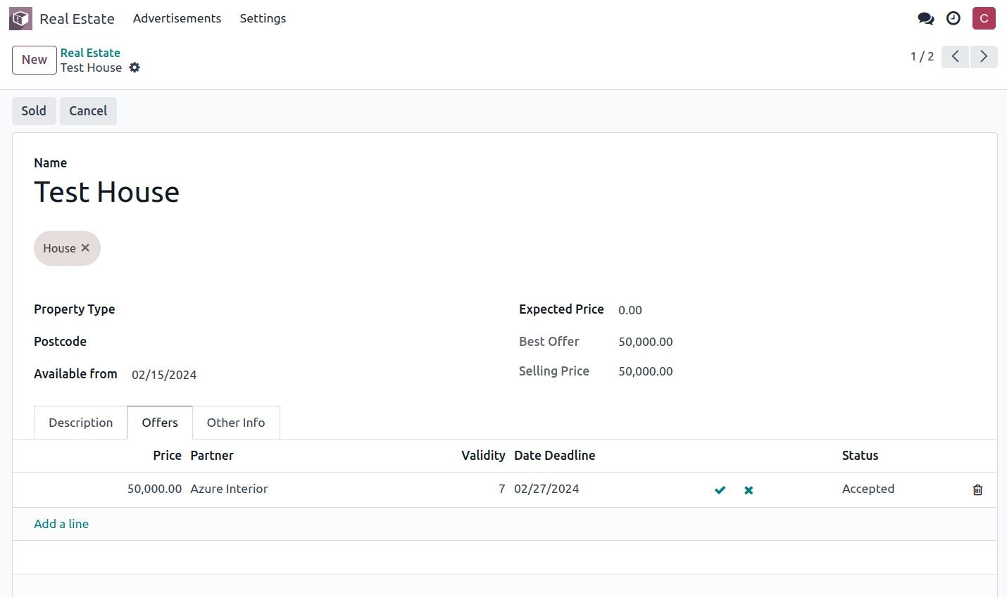
Exercise
Lesson 6
Attributes
Advanced attributes
List attributes
List decorator
Default filter
Domain
Simple widgets
Advance widgets
Inline tree
In the estate.property model form view, adapt the offers inline tree view to match the following example:

Slide 36

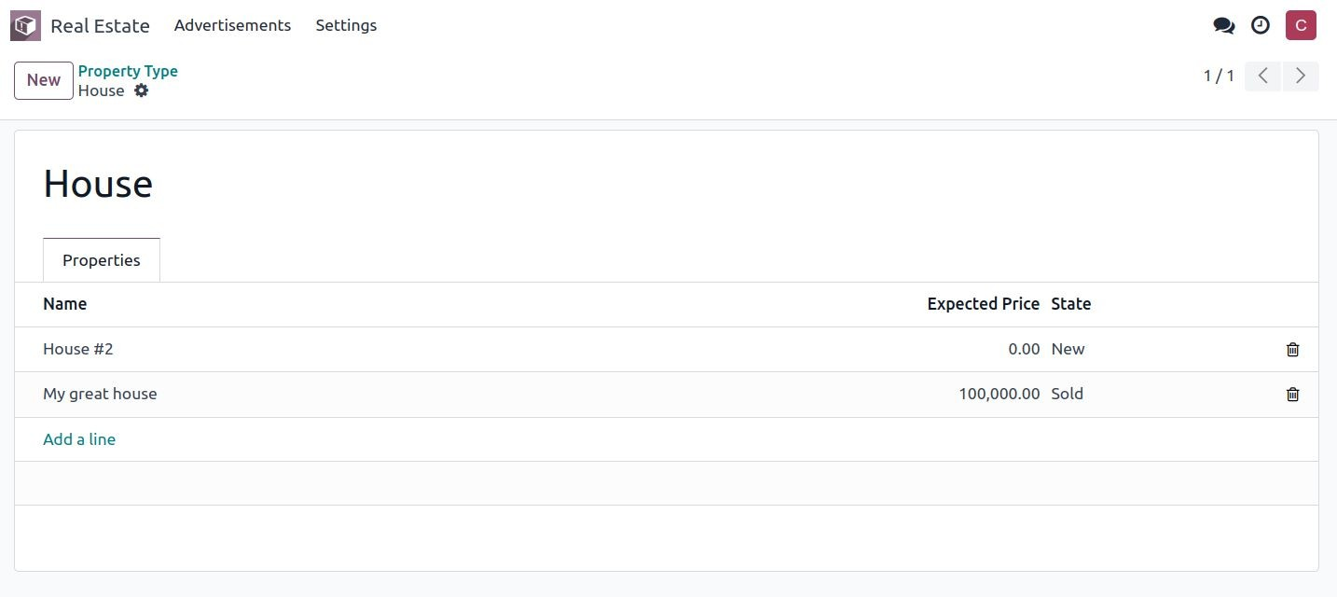
Exercise
Lesson 6
Attributes
Advanced attributes
List attributes
List decorator
Default filter
Domain
Simple widgets
Advance widgets
Inline tree
Add an inline list view.
Add the One2many field property_ids to the estate.property.type
model.
Add the field in the estate.property.type form view.

